Slide 1
Digital Citizenship
Mr. Roberts & Mr. Palm
Elementary - 2017-2018

Slide 2
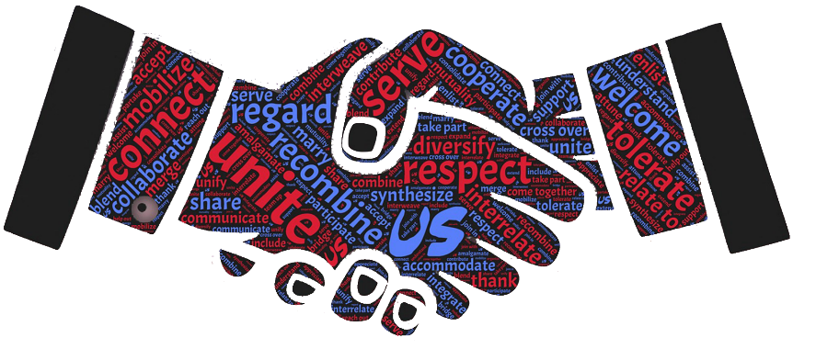
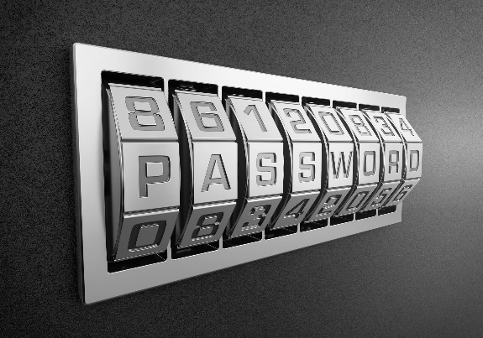
What is Digital Citizenship?
Making correct online choices
Respect
Usernames and Passwords
Permissions
Responsibility

Slide 4
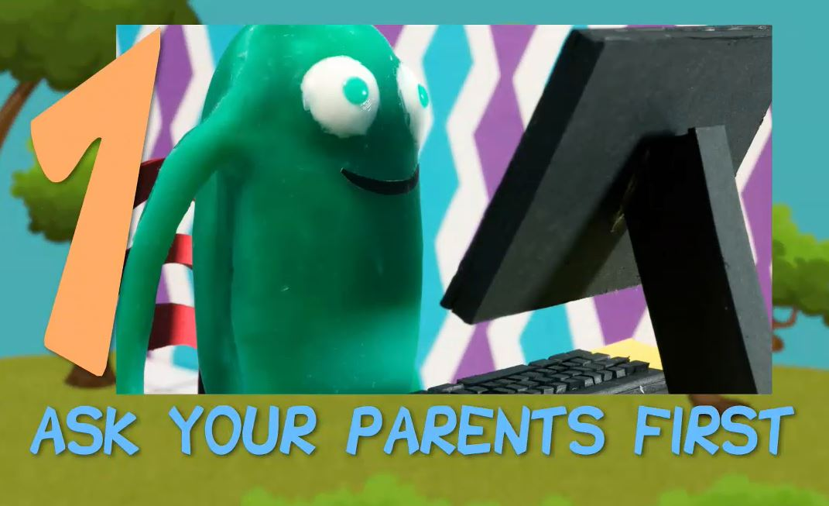
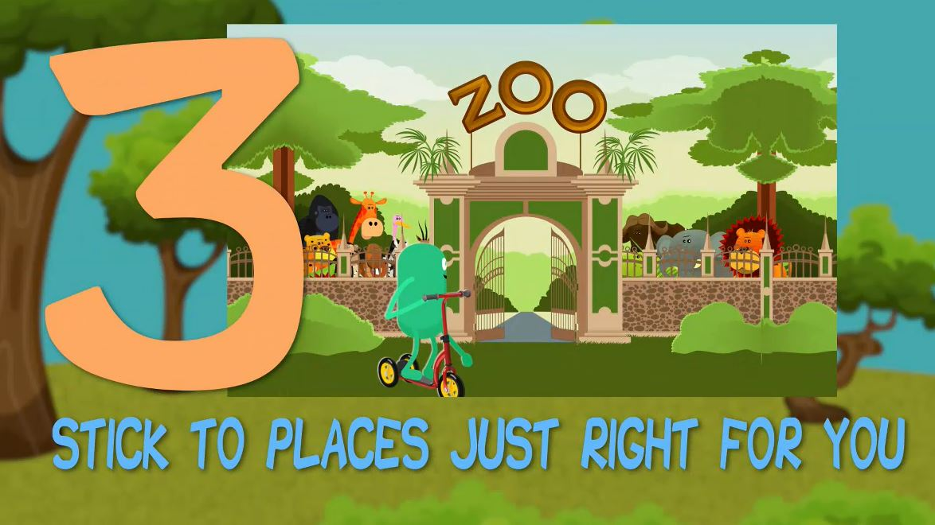
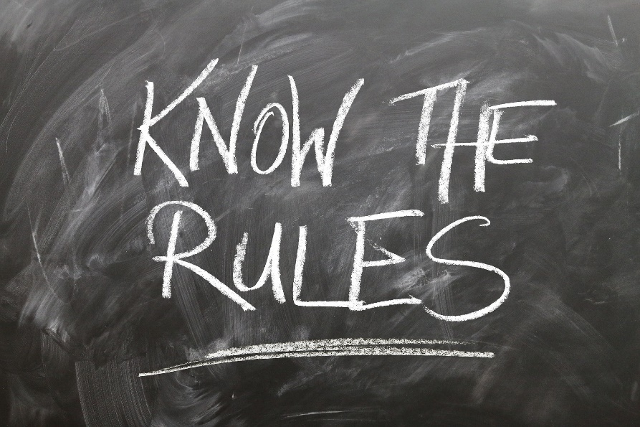

Slide 5
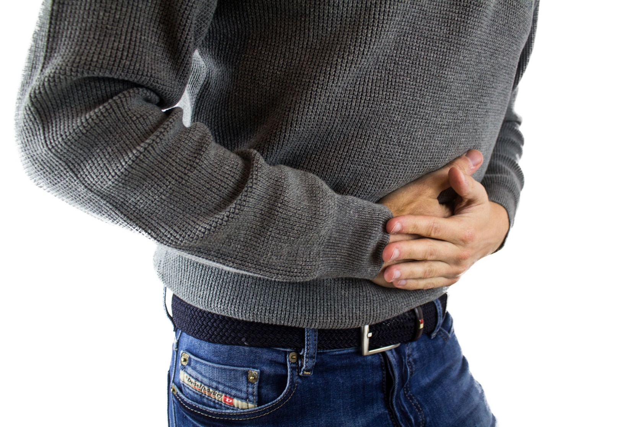

Slide 6
“Traffic Light Analogy”
Okay

Slide 7
“Traffic Light Analogy”
Iffy

Slide 8
“Traffic Light Analogy”
Risky

Slide 9
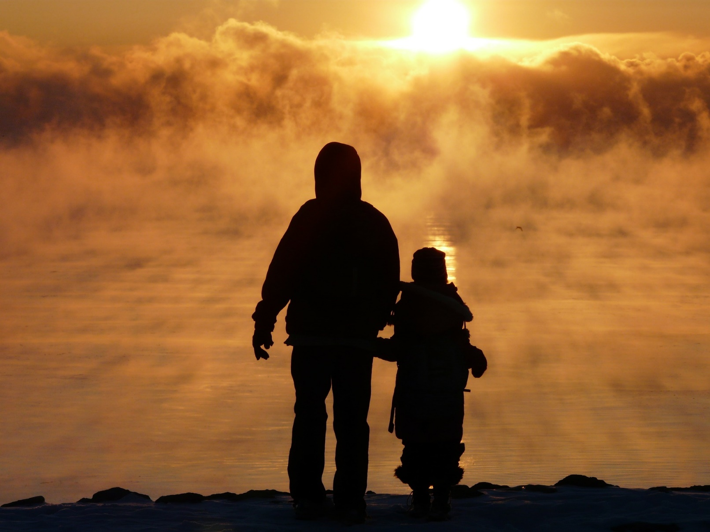
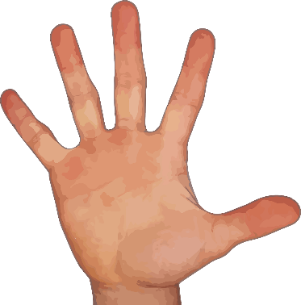
Trusted Adults

Slide 11
